Slide 1
Detailed analysis of Spread & control of
Covid - 19

Slide 2
6.5 Million Deaths
619 Million Cases

Slide 3
Death rate is very high in January 2021

Slide 4
Vaccination efforts from mid-2021 reduced the death rate

Slide 5
Spread by Income wise High Income has very high spread of Covid

Slide 6
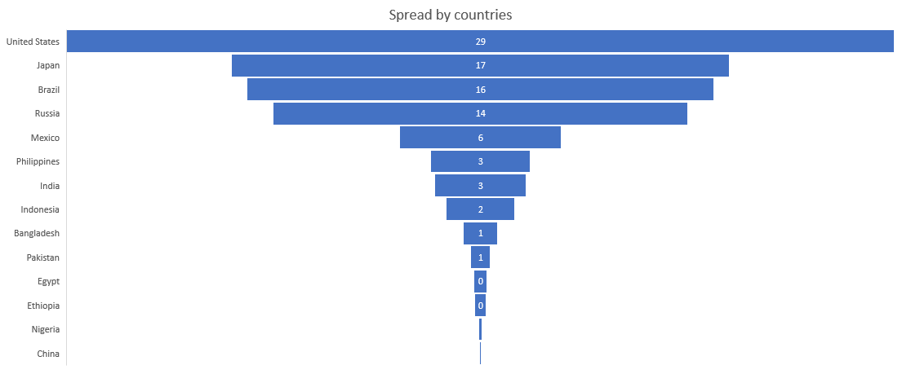
Spread by country (US has very high spread of Covid)

Slide 7
Spread Vs GDP

